Slide 1
Advancells Infertility Related Diseases
Erectile Dysfunction

Slide 2
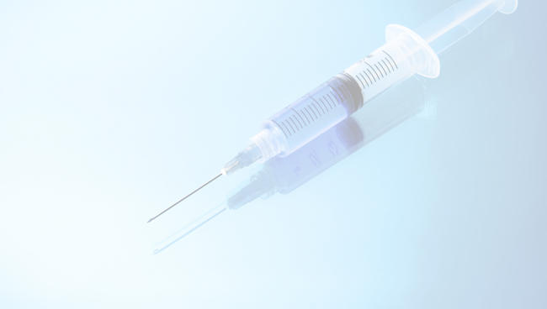
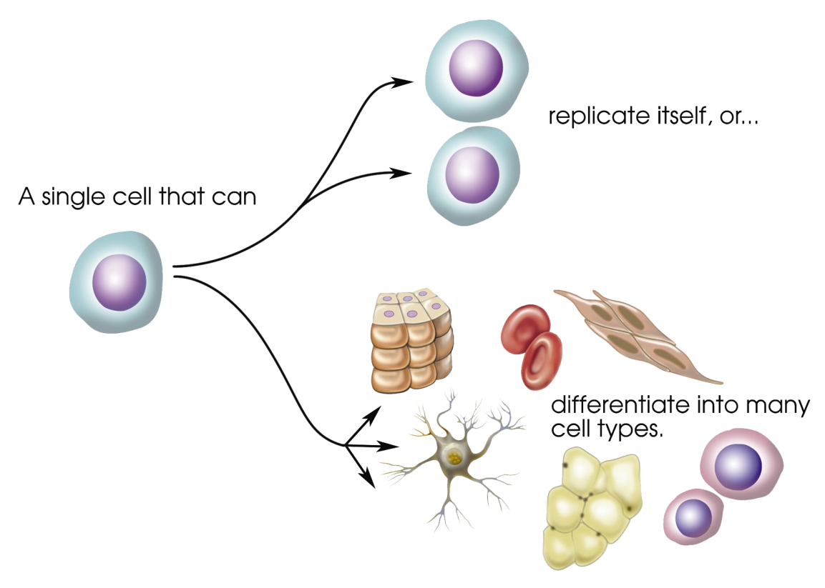
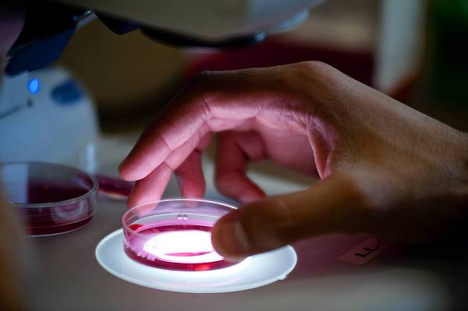
What are Stem Cells ???
“Stem cells have the remarkable potential to develop into many different cell types in the body during early life and growth.”
Adult Stem Cells

Slide 3
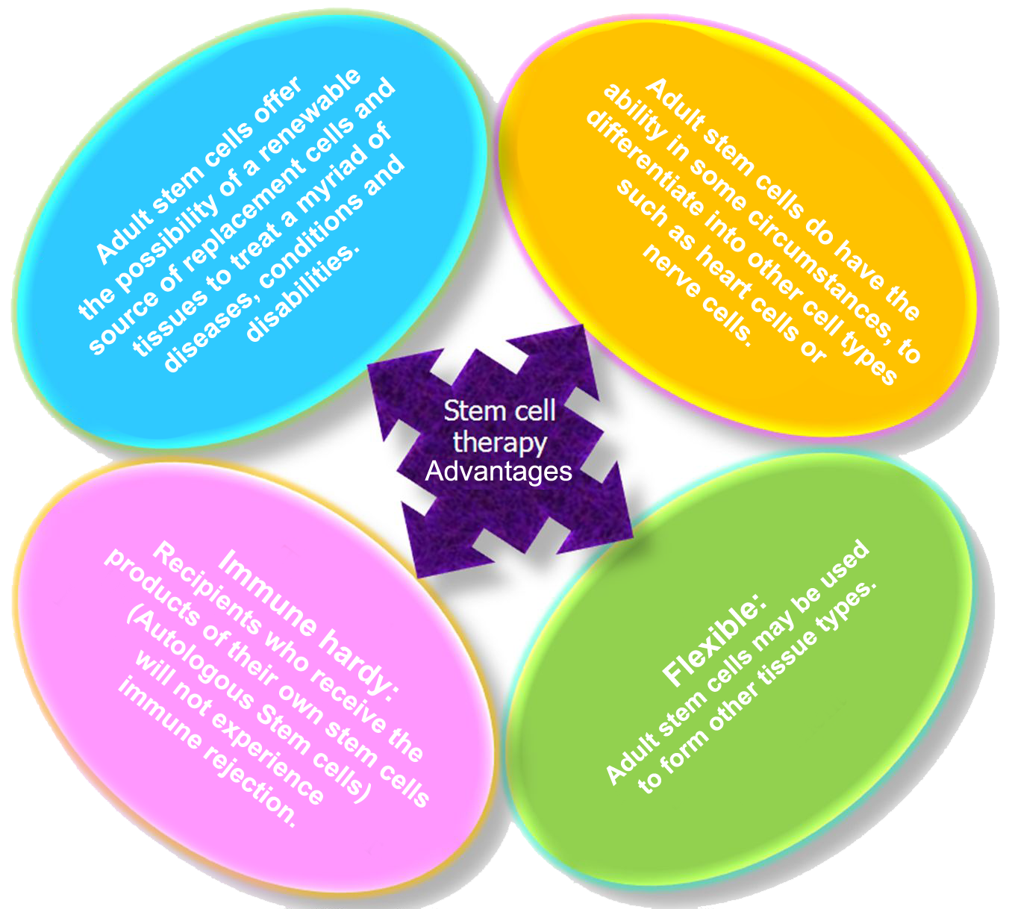
Advancells Advantages of
Stem Cells…

Slide 4
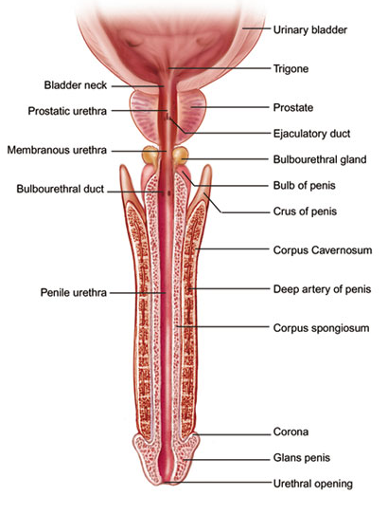
What is Erectile Dysfunction???
“Impotence is the common term which depicts Erectile Dysfunction. It may be defined as the inability to keep one’s penis erect for a long span to have an effective round of sexual coitus. Impotence is also used to describe sexual problems of human being related to coitus and reproduction. The lack of sexual desire and problems related to orgasm or ejaculation is also considered under the term Impotence. “

Slide 5
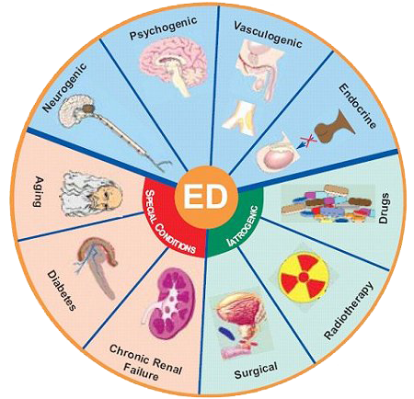
Drugs
Endocrine
Vasculogenic
Chronic Renal Failure
Radiotherapy
Neurogenic disorders
Cavernosal disorders
Psychological causes
Surgery
Aging
Kidney failure
Diabetes and Multiple Sclerosis (MS)
Smoking
Causes Erectile Dysfunction

Slide 6
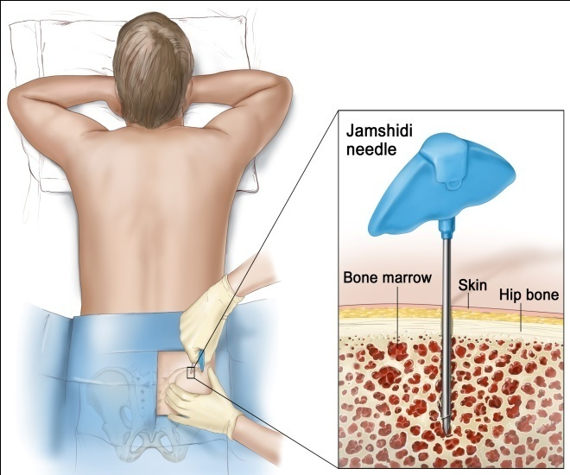
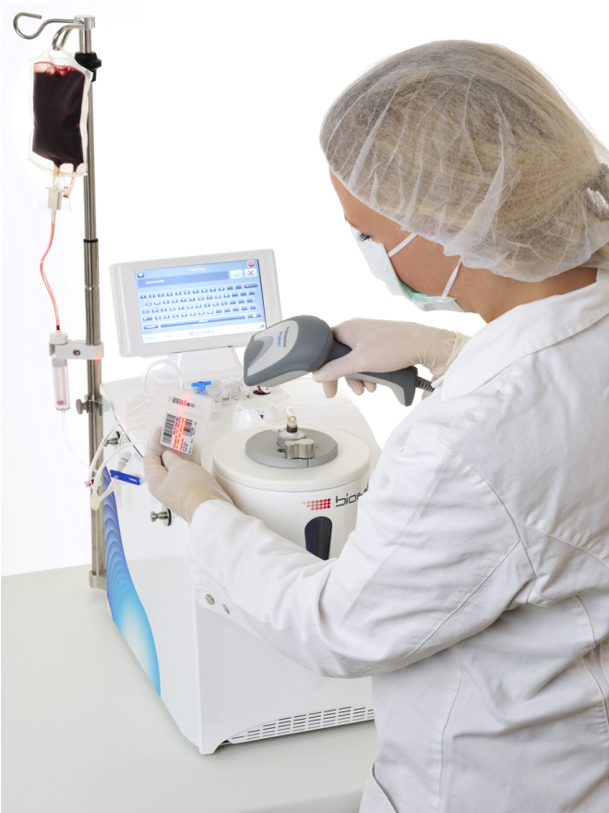
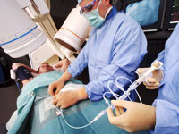
Advancells Treatment for Cardiovascular Diseases
Step 1
Bone Marrow Collection
Step 2
Laboratory Processing
Step 3
Stem Cell Implantation
The collection of bone marrow is done from the hip bone (iliac crest) of the patient by using a thin needle to mini-puncture the skin under local anesthesia.
The prepared stem cells are infused into the pancreatic artery through a fine wire which has already been inserted into the patient’s right femoral artery. The entire process is done under local anesthesia. An X-ray image is used to guide through the penile artery where the stem cells are released through a very small opening of the catheter. The entire process takes around 90 minutes.
The stem cells from the collected bone marrow are evaluated to measure their strength and vitality in our government-approved (cGMP),
ultramodern laboratory.

Slide 7
Case Example
(Pre Stem Cell treatment symptoms)
Name of Patient : Aaron Wood, (Age 60 - 3 heart attacks and heart failure)
He suffered from a massive heart attack in 1988, the result was a necrosis of the backside of his heart. A large part of his cardiac muscle was replaced by scar tissue. Two more heart attacks followed in 1990 and 1992. In 1994, he was diagnosed with congestive heart failure.
His active life as a rancher was over after the first heart attack. It seems a family tradition: 16 Woods passed away from heart-damage and he was living in constant fear of dying.
During these years he turned down two possible heart transplants because he did not want to live with the immune suppressive medications for the rest of his life.

Slide 8
Post Stem Cells Treatment
Name of Patient : Aaron Wood, (Age 60 - 3 heart attacks and heart failure)
A recent check-up showed his EF capacity at 45 - 55 %. Just two weeks after treatment, he went from 15 prescription pills per day down to 2, walk 2.5 miles without turning blue, lift weights and - finally after 22 years - live a normal life.
Now, he is going for skydiving next weekend, something he last enjoyed 3 years ago.
He no longer have any angina pain or no shortness of breath - no symptoms whatsoever. He can walk 3 miles per day and lift heavy weights again.
He consider this a complete reversal. He saw his cardiologist 2 weeks ago for more testing and he is still shaking his head.

Slide 9
A total number of 21 patients with heart complications were put under observation after the ischemic heart disease treatment.
A whopping 88% of the patients showed clinical improvements.
Few of the various improvements reported were - less shortness of breath, reduction in medication, less weakness, less tiredness and less edema.

Slide 10
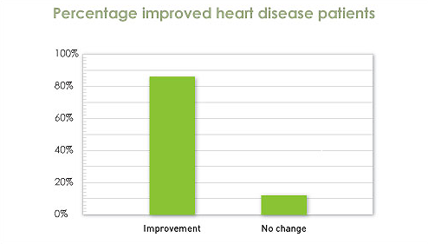
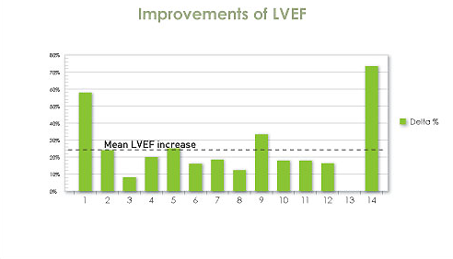
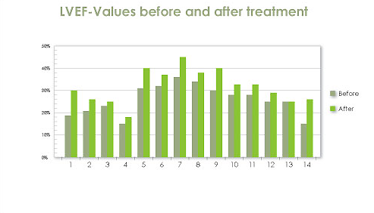
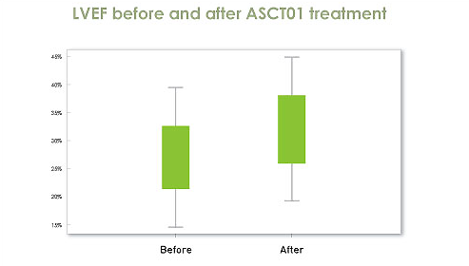
Some Facts

Slide 11
Contact us
8000+ lives touched
For more details visit: www.advancells.com or E-mail: info@advancells.com
A-102, Sector V, NOIDA-201 301
U.P – INDIA
Helpline
India : + 91 965 432 1400
UK : + 44 203 514 1007
US : + 1 202 643 3921
Bangladesh : + 880 1929 000 000

